Slide 1

MRA Project - Milestone 2
DATA – DATASET
GROUP
NAME – VIVEK
AUGUSTINE
DATE – 04/12/22

Slide 2
CONTENT
Exploratory Analysis
Exploratory Analysis of data & an executive summary (in PPT) of your top findings, supported by graphs.
Are there trends across months/years/quarters/days etc. that you are able to notice?
Use of Market Basket Analysis (Association Rules)
Write Something about the association rules and their relevance in this case
Add KNIME workflow Image
Write about threshold values of Support and Confidence
Associations Identified
Put the associations in a tabular manner
Explain about support, confidence, & lift values that are calculated
A suggestion of Possible Combos with Lucrative Offers
Write recommendations
Make discount offers or combos (or buy two get one free) based on the associations and your experience

Slide 3
PROBLEM STATEMENT
A Grocery Store shared the transactional data with you. Your job is to identify the most popular combos that can be suggested to the Grocery Store chain after a thorough analysis of the most commonly occurring sets of menu items in the customer orders. The Store doesn’t have any combo meals. Can you suggest the best combo meals?

Slide 4
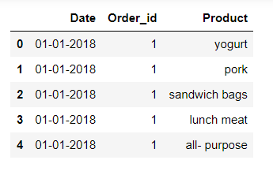
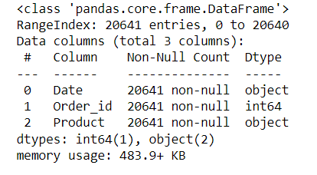

SUMMARY OF DATA
Table
INFORMATION
DESCRIPTION

Slide 5
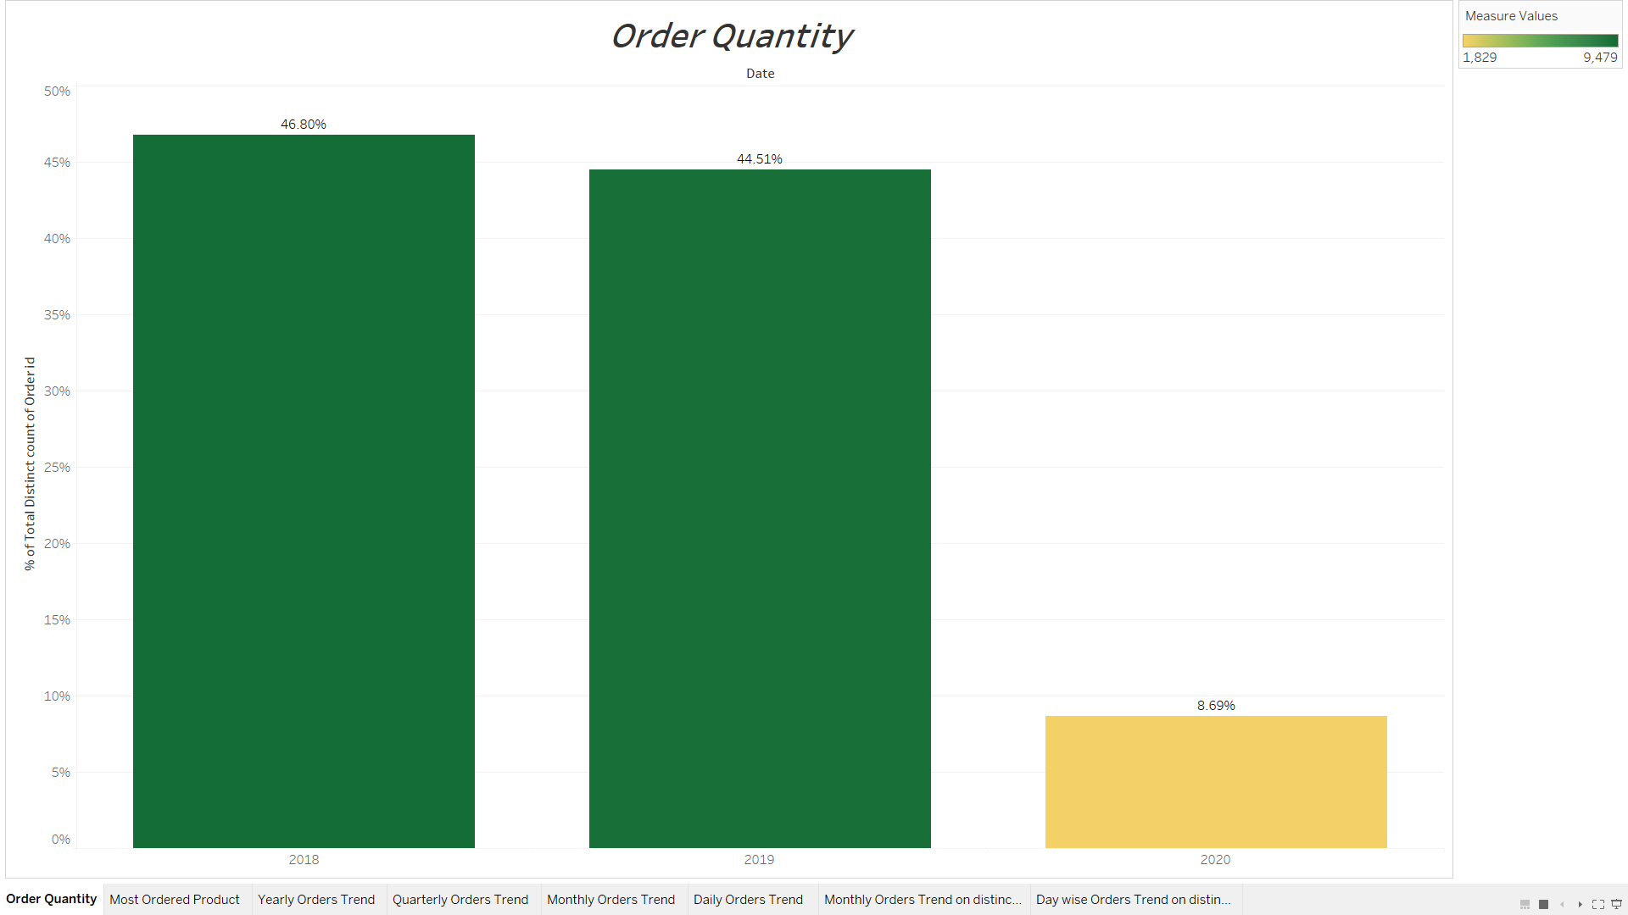
EDA
HERE, WE CAN SEE PERCENTAGE OF ORDER QUANTITY AS PER ORDER ID.
YEAR :
2018 – 46.80%
2019 – 44.51%
2020 – 8.69%
YEAR 2018 HAS THE HIGHEST PERCENTAGE OF ORDER FOLLOWED BY YEAR 2019 & 2020.

Slide 6
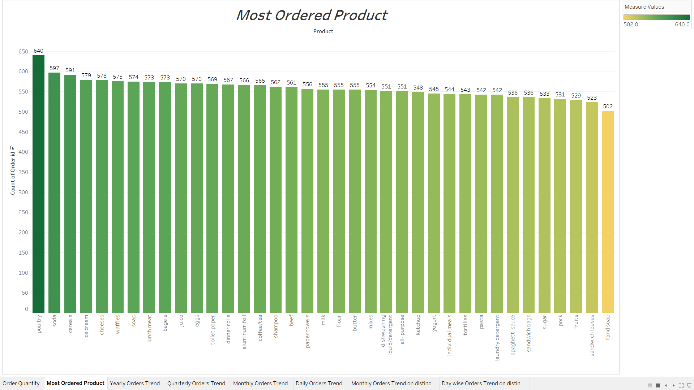
MOST ORDERED PRODUCT
HERE, WE CAN SEE THE MOST ORDERED PRODUCT AND THE LEAST ORDERED PRODUCT
TOP 3 :
1.POULTRY - 640
2.SODA - 597
3.CEREALS - 591
LEAST 3:
1.HAND SOAP - 502
2.SANDWICH
LOAVES - 523
3.FRUITS - 529

Slide 7
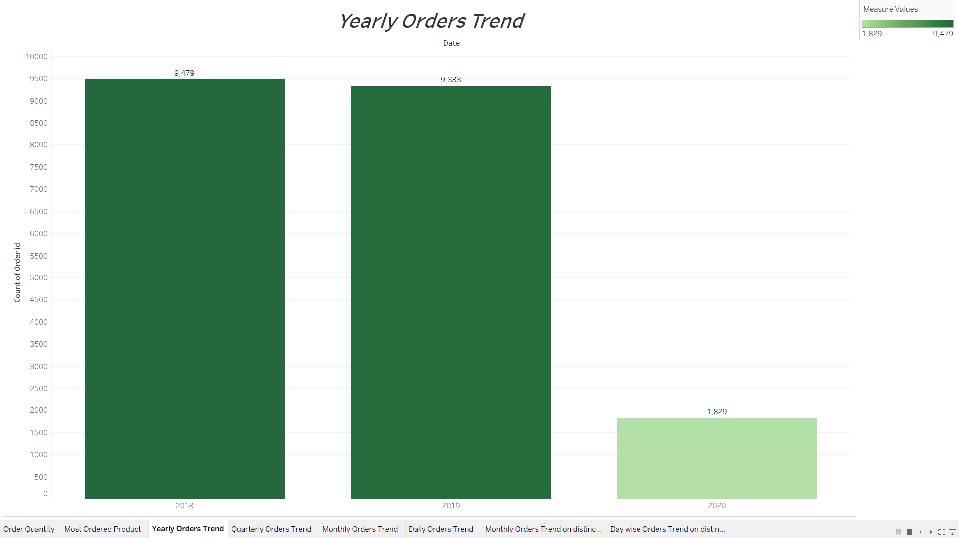
YEARLY ORDER TREND
HERE, WE CAN SEE ORDERLY TREND WITH RESPECT TO ORDER IDs
YEAR:
2018 WITH 9,479 ORDERS.
2019 WITH 9,333 ORDERS.
2022 WITH 1829 ORDERS.
THESE ARE SALES IN A PARTICULAR YEAR

Slide 8
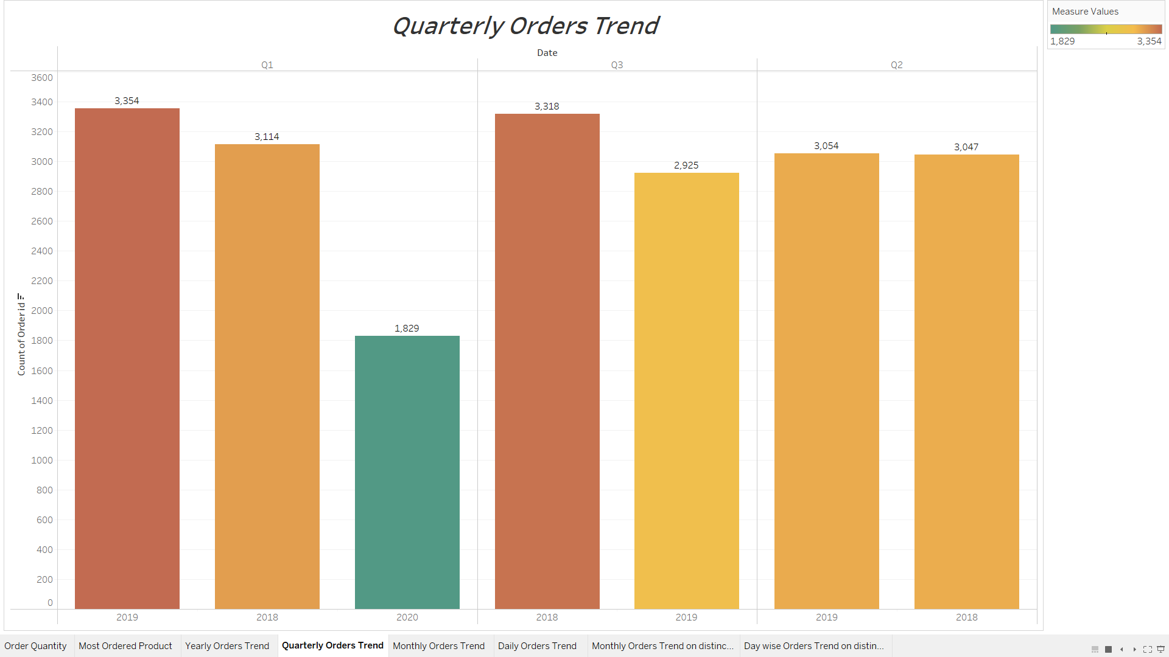
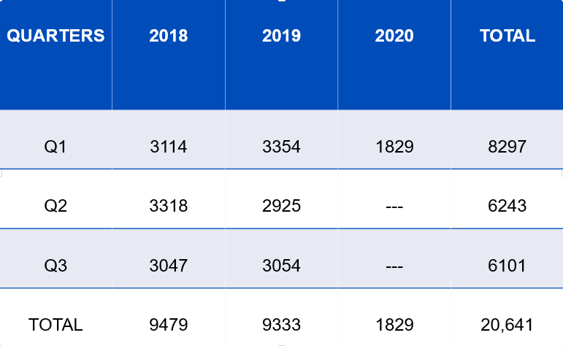
QUARTERLY TREND
QUARTER:
HERE, WE CAN SEE QUARTERLY TREND WITH RESPECT TO THEIR ORDERS IN EACH YEAR

Slide 9
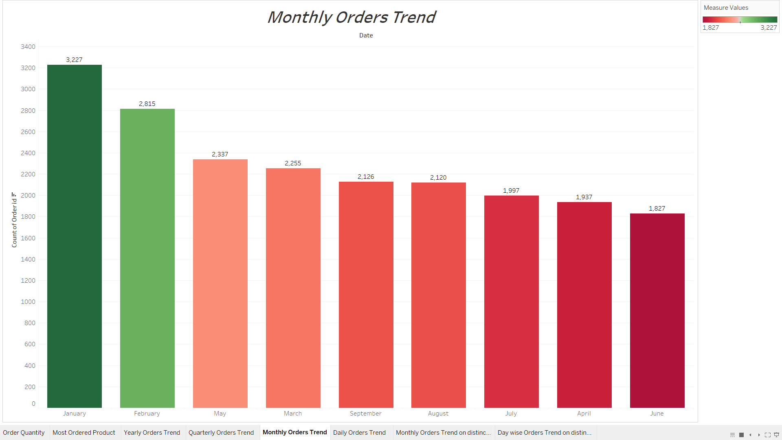
MONTHLY TREND
HERE, WE CAN SEE MONTHLY TREND & THE AMOUNT OF SALES DONE IN A PARTICULAR MONTH.
JAN – 3,227.
FEB – 2,815.
MAR – 2,255.
APR – 1,937.
MAY – 2,337.
JUN – 1,827.
JUL – 1,997.
AUG – 2,120.
SEP – 2,126.
NO OF ORDERS IN EACH MONTH

Slide 10
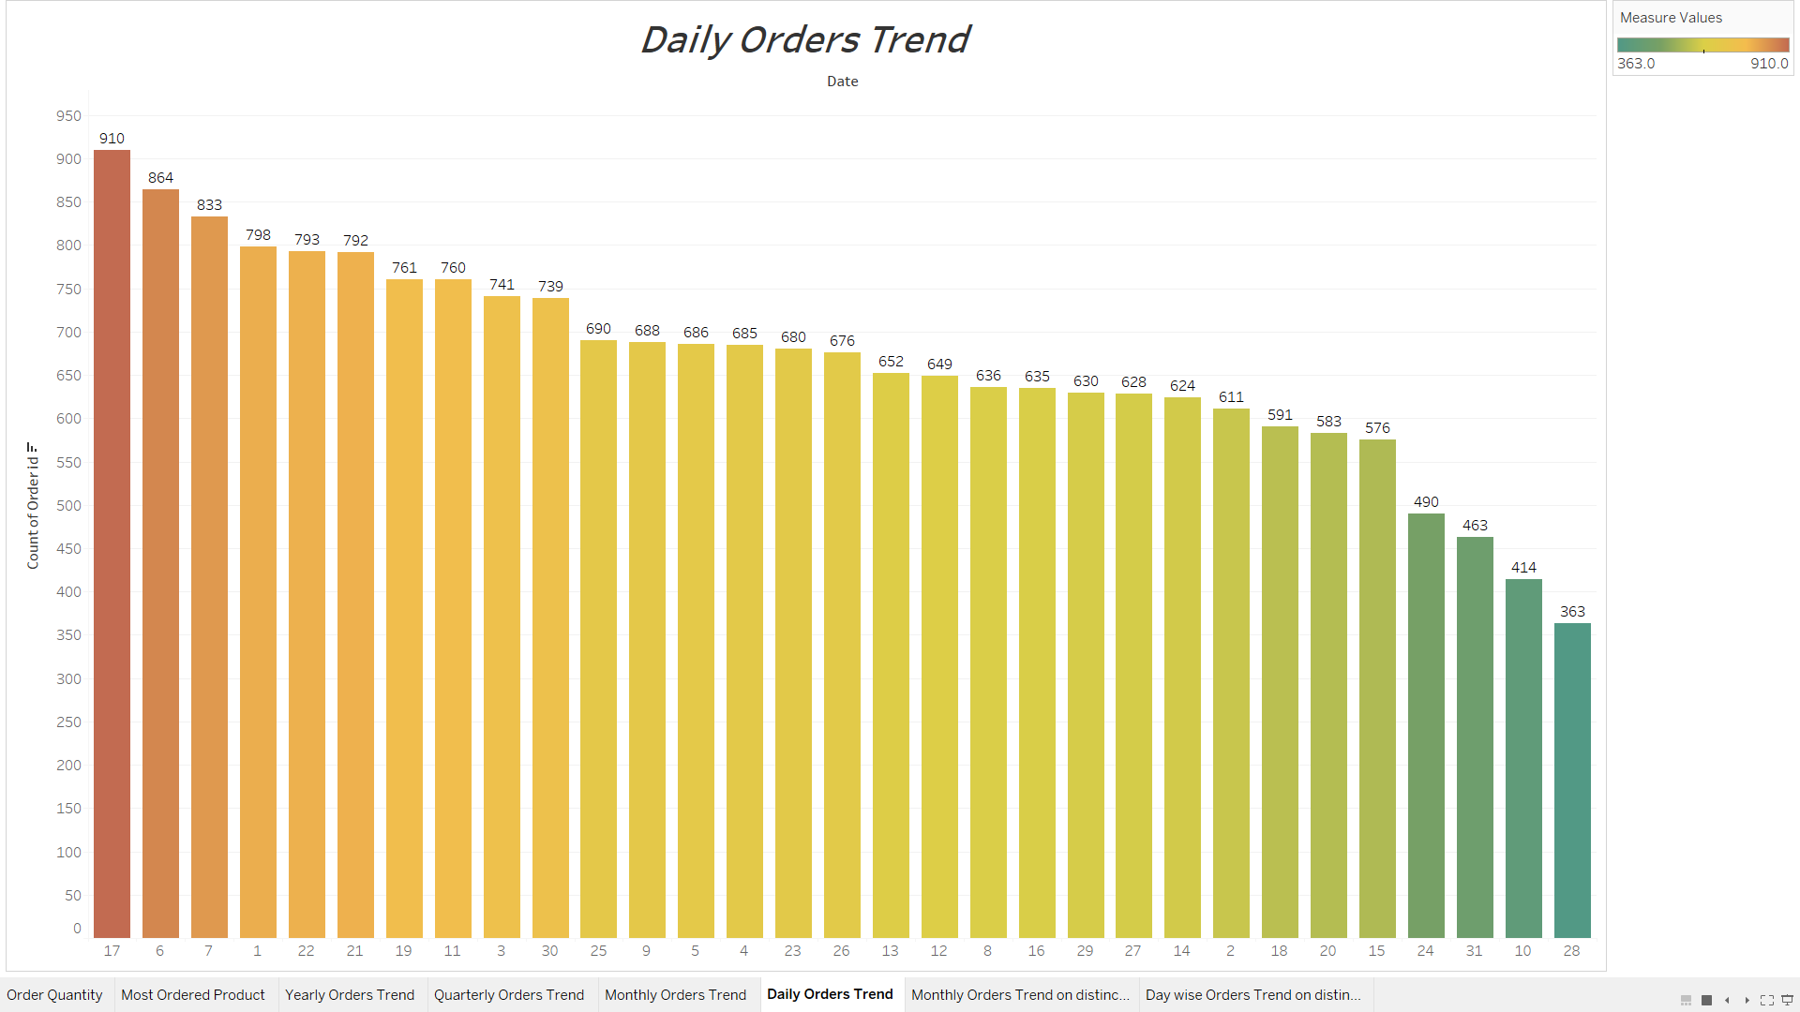
DAILY ORDER TREND
HERE, WE CAN SEE DAILY ORDER TREND WITH RESPECT TO ORDER SALES IN PARTICULAR DAY.
TOP 3 DAYS:
17th – 910.
6th – 864.
7th – 833.
LEAST 3 DAYS:
28TH – 363.
10TH – 414.
31ST – 463.

Slide 11
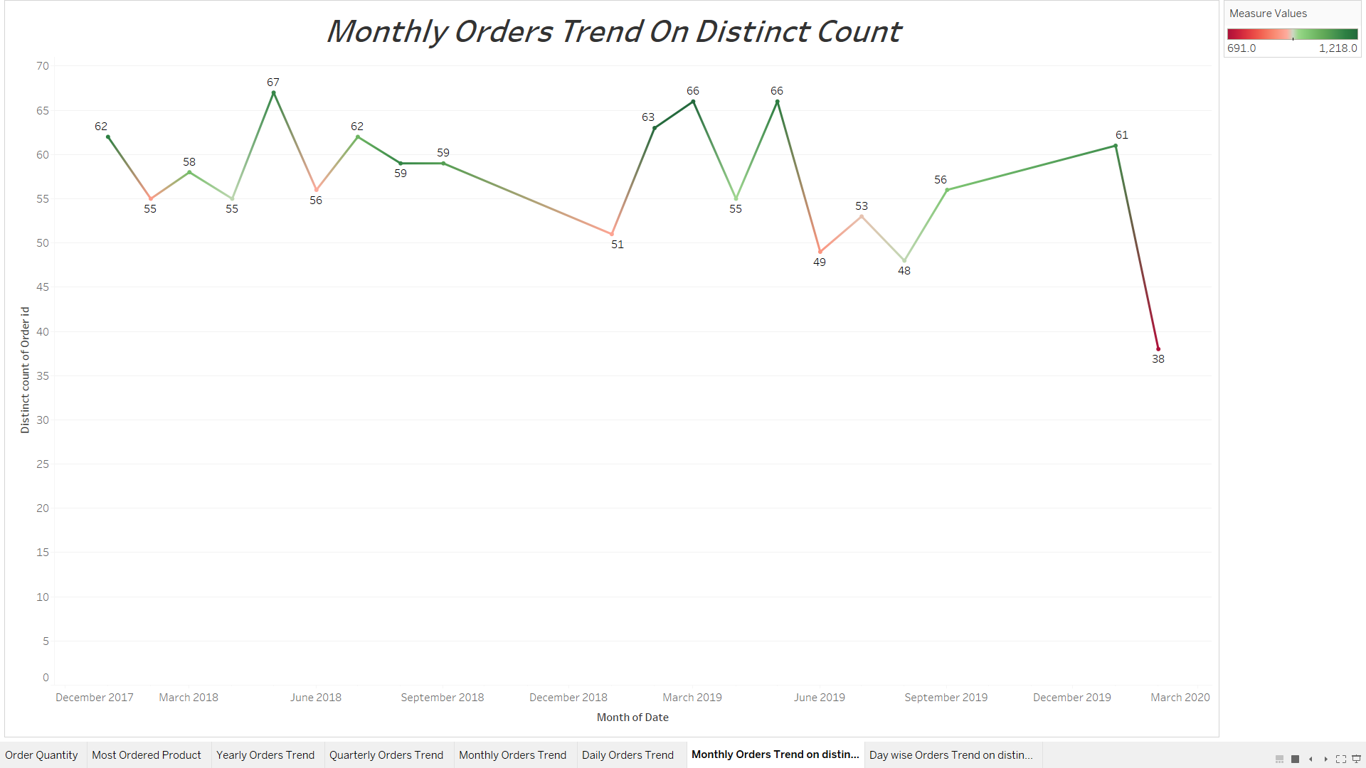
MONTHLY ORDER TREND ON DISTINCT COUNT
HERE WE CAN SEE MONTHLY ORDER TREND WITH RESPECT TO DISTINCT COUNT
TOP 3:
MAY 2018 – 67.
MARCH 2019 – 66.
MAY 2019 – 66.
LEAST 3:
FEB 2022 – 38.
AUGUST 2019 – 48.
JUNE 2019 – 49.

Slide 12
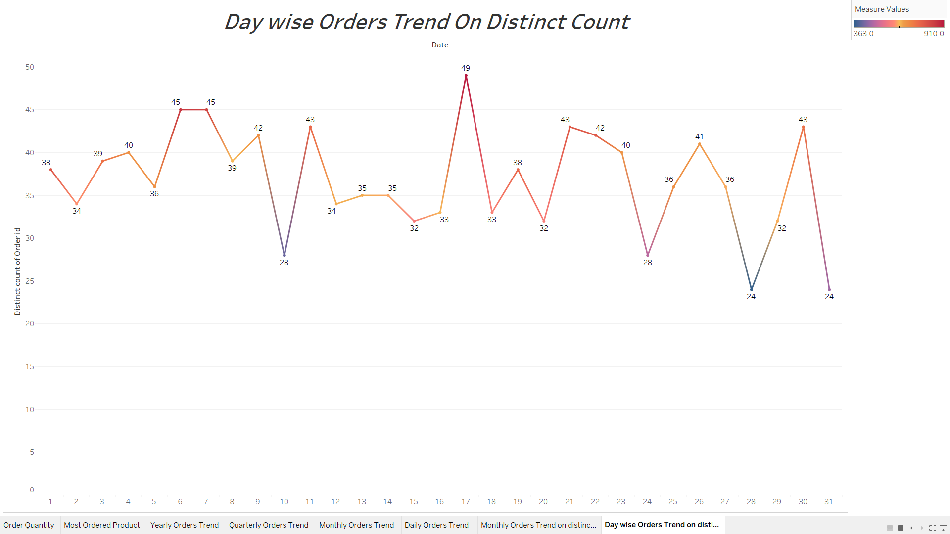
DAILY ORDER TREND ON DISTINCT COUNT
HERE WE CAN SEE DAY TO DAY ORDER TREND WITH RESPECT TO SALES OF NO OF ORDERS ON EACH DAY.
TOP 3:
17th – 49.
6th – 45.
7th – 45.
LEAST 3 DAYS:
31ST – 24.
28TH – 24.
24TH – 28.

Slide 13
INFRENCES FROM THE ABOVE ANALYSIS
In the year 2018, number of orders are the highest. In 2020, the data available is only for 2 months hence the number of orders are less compared to the other two years ( 2018,2019)
There is no trend and seasonality available in the data provided.
Orders made during mid of the month are high and less during the beginning of the month.
Q1 of 2019 and Q3 of 2018 has the highest number of orders.
Q1 of 2020 has the lowest number of orders since the data available is only for two months.

Slide 14
Market Basket Analysis (Association Rules)
Market basket analysis is a data mining technique used by retailers to increase sales by better understanding customer purchasing patterns. It involves analyzing large data sets, such as purchase history, to reveal product groupings, as well as products that are likely to be purchased together. For example, people who buy green tea are also likely to buy honey. So Market Basket Analysis would quantitatively establish that there is a relationship between Green Tea and Honey.

Slide 15
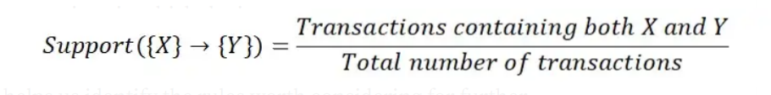
SUPPORT
This measure gives an idea of how frequent an itemset is in all the transactions.
Value of support helps us identify the rules worth considering for further analysis. For example, one might want to consider only the itemsets which occur at least 50 times out of a total of 10,000 transactions i.e. support = 0.005. If an itemset happens to have a very low support, we do not have enough information on the relationship between its items and hence no conclusions can be drawn from such a rule.

Slide 16
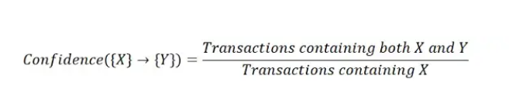
Confidence
This measure defines the likeliness of occurrence of consequent on the cart given that the cart already has the antecedents.
Technically, confidence is the conditional probability of occurrence of consequent given the antecedent. It does not matter what you have in the antecedent for such a frequent consequent. The confidence for an association rule having a very frequent consequent will always be high.

Slide 17
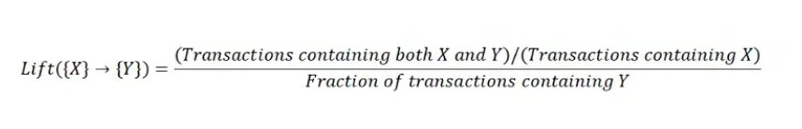
Lift
Lift controls for the support (frequency) of consequent while calculating the conditional probability of occurrence of {Y} given {X}.
In cases where {X} actually leads to {Y} on the cart, value of lift will be greater than 1. Lift is the measure that will help store managers to decide product placements on aisle.

Slide 18
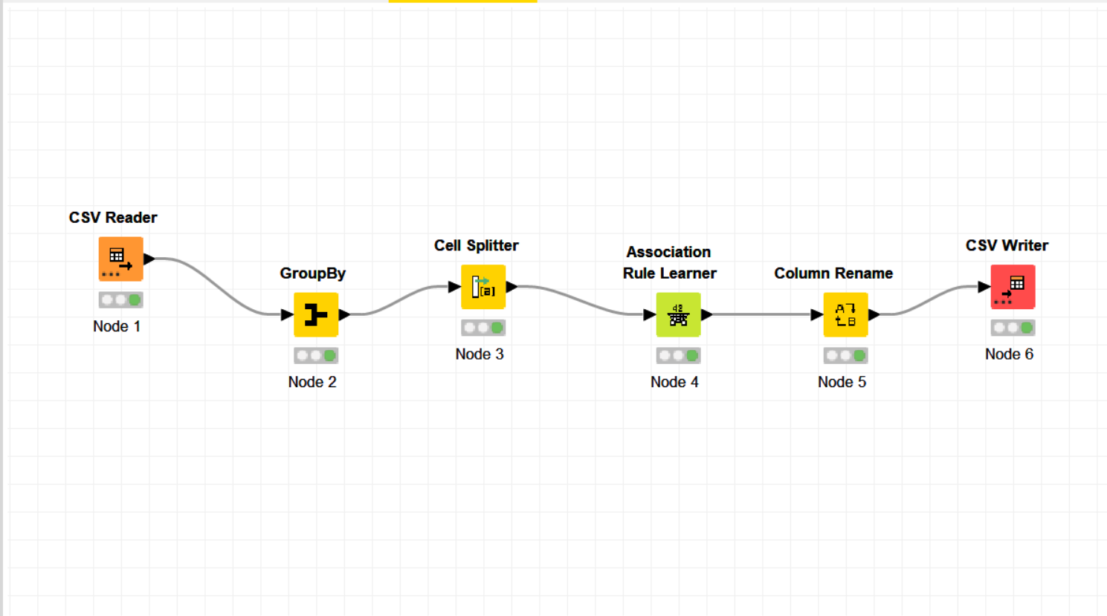
KNIME workflow Image

Slide 19
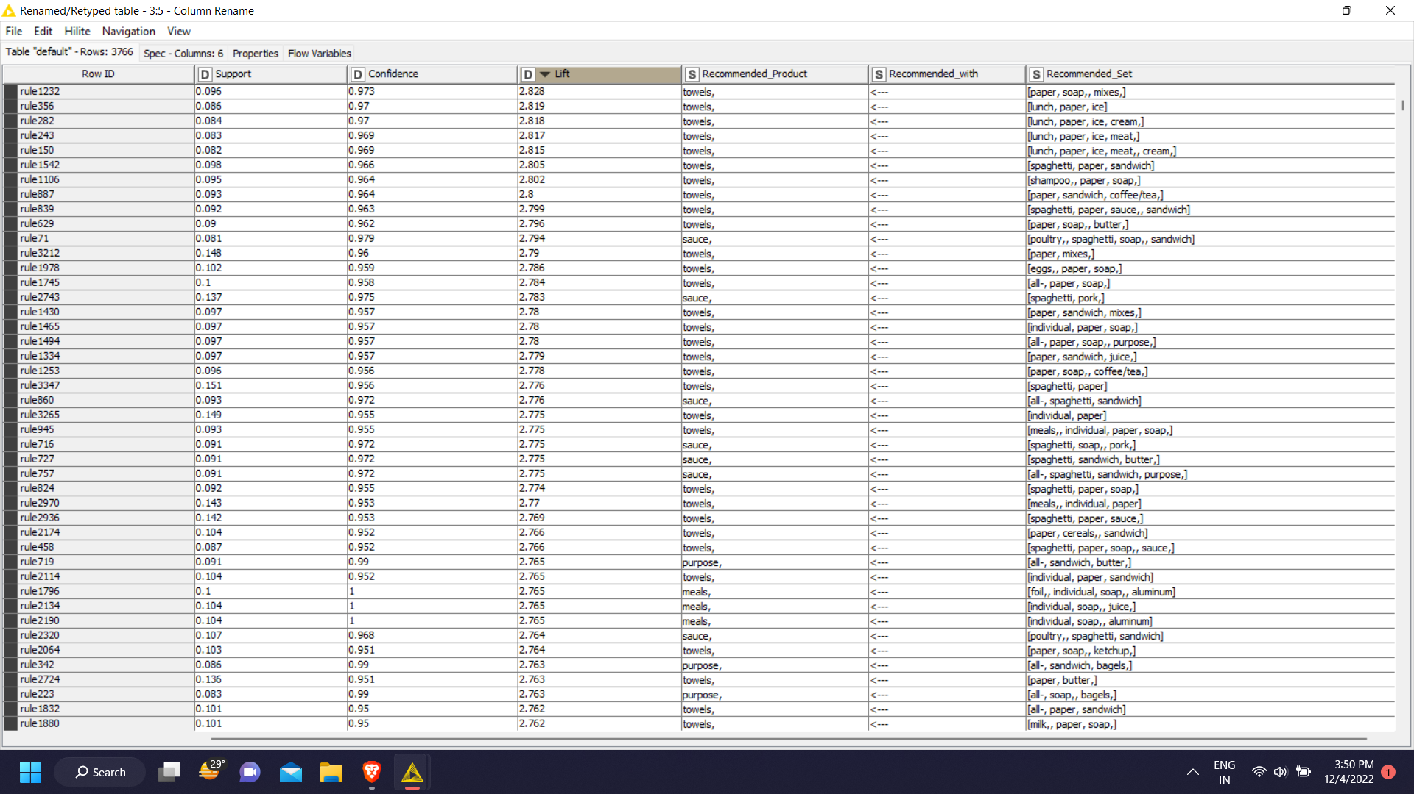
ASSOCIATIONS IN A TABULAR MANNER

Slide 20
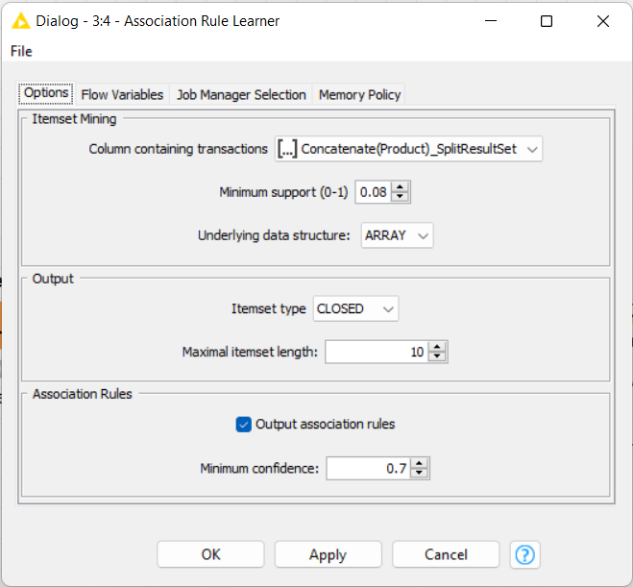
Explain about support, confidence, & lift values that are calculated
I’VE SUPPORT AS 8% AND CONFIDENCE AS 70% SO THAT I CAN GET THE MOST OUT OF THE DATA THAT WE’VE GIVEN MY GOAL WAS TO PICK THAT SORTS OF COMBINATION THAT ARE GOING TO HAPPEN THE MOST AND ARE HAPPENING IN THE DATA SO HENCE THE VALUE I CHOSE IT FOR THE MAXIMUM ACCURACY SO I CAN GET THE BEST POSSIBLE COMBINATION AND WILL MAKING MY COMBINATION WITH THE VALUE OF LIFT WHICH IS A CALCULATED COMBINATION OF BOTH SUPPORT AND CONFIDENCE.

Slide 21
RECOMMENDATIONS
OPTIMUM COMBINATIONS
1. towels, | [paper, soap, mixes]
2. sauce, | [poultry, spaghetti, soap, sandwich]
3.purpose, | [all-, sandwich, butter,]
4.meals, | [foil, individual, soap, aluminum]
5.detergent, | [laundry, yogurt, soap]
6.paper, | [toilet, spaghetti, soap]
7.foil, | [soap, aluminum, ketchup,]
8.individual | [meals, lunch, waffles]

Slide 22
COMBINATIONS
These are the best combination we could get from the data and these are the combination i suggest to the shopkeeper to keep with him because these are the most probable things a customer would buy from the store.
9.cream, | [lunch, individual, ice, meat,]

Slide 23
OFFERS
Since Poultry and Soda are the most sold items and hand soap and Sandwich loaves are the least – a combo offer of these would eventually increase a sale of Hand soap and Sandwich loaves as well.
Another strategy could be to have sale offer on the least sold products to increase its sales.
We can also keep least sold product between the most sold product on the aisle so as the customer walk through the aisle chances are he can buy some of those products as well
Another strategy could be to give a offer of buy 1 get 1 free so that our commodities can be sold properly.
Since soap is getting repeated so many times we can offer free soaps or can have sale on them with different combos.

Slide 24
Tableau Link
https://public.tableau.com/app/profile/vivek.rajeshkumar.augustine/viz/MRA_Milestone_2_16701330442530/OrderQuantity?publish=yes

